Slide 1
FRB Update #2
William Huang
(6/20/2020)

Slide 2
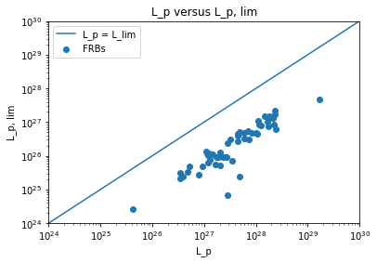
L_p vs. L_lim graph
My previous values of L_lim were wrongly calculated. The new graph is shown with the line L_p = L_lim:

Slide 3
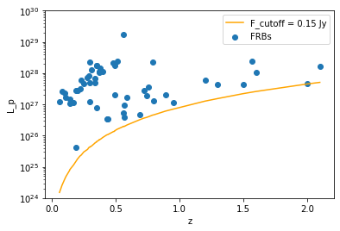

L_p vs. z graph
Plotted L_p with z, and manually used a flux cutoff of F_cutoff = 0.15 Jy
Used the formula to the right to calculate the luminosity cutoff at a given z:

Slide 4
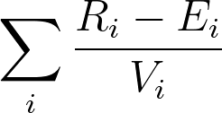
Questions about Kendell’s Tau
Does rank mean the relative order of L for data point i?
Does expectation mean the relative order of z for data point i?
What is the variance of data point i?
For example, for the data table on the right: Would the expectations be 1, 2, 3, while the ranks are 3, 1, 2?
Additionally, what would V_i be, the variance? I don’t quite understand why E_i = 0.5 for a uniform distribution, nor why V_i = √12.
 | z | L
Data #1 | 0.2 | 5
Data #2 | 0.3 | 2
Data #3 | 0.4 | 3

Slide 5
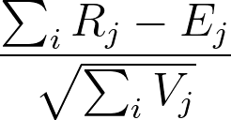
(cont.)
Additionally, I also found this equation in papers:
My assumptions about this equations meaning:
i is the data point
And j is another data point within the associated set
L_J > L_min, z_J < z_i
R_j is the rank of one data point within the associated set
Is this version something I should use? I am also unsure about the meaning of rank, expectation and variance in this context.

